Slide 1

Presented By:
Batch:10,
Sahitya.N,
B.Vijetha, T.Chinnababu.
Guided by:
A.L.Lavanya.

Slide 2
CONTENTS:
Introduction.
Objective.
Existing system.
Proposed System.
Image authentication methods.
Modules.
Architecture.
Framework.
Image signing procedure.
Image authentication procedure.
RSA Algorithm.
Sample images.
Screen shots.
Conclusion.

Slide 3
INTRODUCTION:
Recent advances in networking and digital media technologies have created a large number of networked multimedia applications.
These Multimedia Application often implemented in Distributed Network Environment.
Distributed network environment that makes multimedia contents vulnerable to privacy and unknown attacks.

Slide 4
For insecure environments, it is possible for an enemy to tamper with image during transmission.
To Guarantee Security, image authentication techniques have proposed to confirm content integrity and prevent forgery.
Such authentication techniques have wide applicability in law, commerce, journalism and national defense.

Slide 5
OBJECTIVE:
The main purpose of the robust and secure digital signature scheme for image authentication is to provide security for multimedia images during transmission in wireless network. It’s objective is to prevent tampering of multimedia images.

Slide 6
Existing System:
Existing methods with content based authentication will assume reliable noise-free transport.
These methods do not work well when used to transmit images over the error-prone wireless channel.

Slide 7
Proposed system:
The Proposed method, content based digital signature method for image authentication.
Here requires careful design of the authentication methodology.

Slide 8

Image Authentication Methods:

Slide 9
Digital Signature methods can work on both the integrity protection of the image and repudiation prevention of the sender.
Watermark-based approaches only work for protecting the integrity of the image.

Slide 10
Modules:
Network module
Authentication module.
Encryption module.
Decryption module.

Slide 11
ARCHITECTURE:
sender Receiver
Network module
Encrypt module.
Authenticate module
Decryption
Authenticate
Network

Slide 12
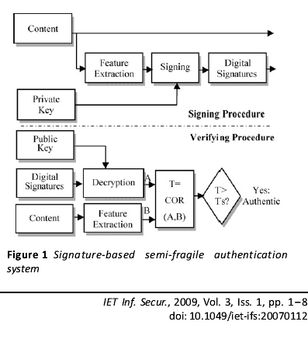
FRAMEWORK:

Slide 13
Image signing procedure:
Signing process on the image in the following order:
Decompose the image using parameterised wavelet filters.
Extract the SDS.
Cryptographically hash the extracted SDS.
Send the image

Slide 14
Image signing procedure:
Signing process on the image in the following order:
Decompose the image using parameterised wavelet filters.
Extract the SDS.
Cryptographically hash the extracted SDS.
Send the image

Slide 15
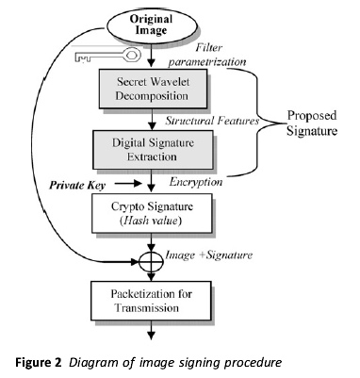
Image signing procedure

Slide 16
Image authentication procedure:
The following process on the image in the following order:
Perform content-adaptive error concealment, if some blocks are damaged.
Extract the SDS.
Decrypt the signature.

Slide 17
Perform content authenticity verification procedure.
The image authenticated.
Else the attacked areas are detected.

Slide 18
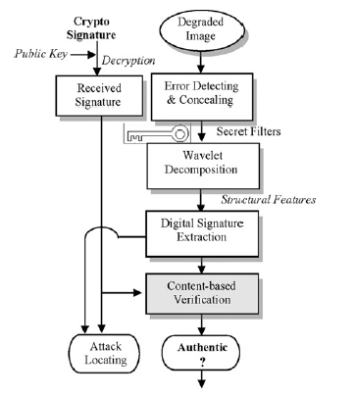
Image authentication procedure

Slide 19
RSA Algorithm
Generate two large random primes, p and q, of approximately equal size such that their product n = pq is of the required bit length.
Compute n = pq and (φ) phi = (p-1)(q-1).
Choose an integer e, 1 < e < phi.
Compute the secret exponent d, 1 < d < phi, such that ed ≡ 1 (mod phi).
The public key is (n, e) and the private key is (n, d). Keep all the values d, p, q and phi secret.

Slide 20
Encryption:
Sender A does the following:-
Obtains the recipient B's public key (n, e).
Represents the plaintext message as a positive integer m
Computes the ciphertext c = m^{e} mod n.
Sends the ciphertext c to B.
Decryption:
Recipient B does the following:-
Uses his private key (n, d) to compute m = c^{d} mod n.
Extracts the plaintext from the message representative m.

Slide 21
Digital signing:
Sender A does the following:-
Creates a message digest of the information to be sent.
Represents this digest as an integer m between 0 and n-1. [See note 5].
Uses her private key (n, d) to compute the signature s = m^{d} mod n.
Sends this signature s to the recipient, B.
Signature verification:
Recipient B does the following:-
Uses sender A's public key (n, e) to compute integer v = s^{e} mod n.
Extracts the message digest from this integer.
Independently computes the message digest of the information that has been signed.
If both message digests are identical, the signature is valid.

Slide 22

Sample Images:
Input image:
Output image:

Slide 23
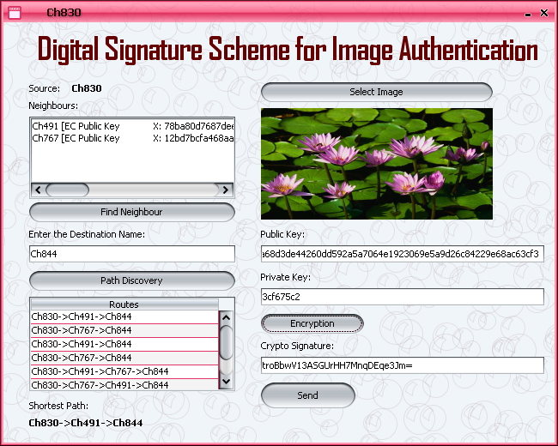
Screens:

Slide 24
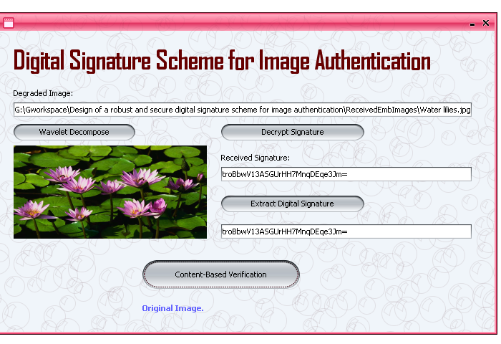

Slide 25
Conclusion:
A modified digital signature for image authentication has been proposed.
Content-dependent structural image features and wavelet filter parameterization are incorporated into traditional crypto signature scheme to enhance the system robustness and security.

Slide 26
References:
Department of information Technology, Institute of Graduate Studies and research, Universities of Alexandria,163 Horreya Avenue EI shatby, po Box 832,Alexandria,Egypt . E-mail:saad.darwish@gmail.com
GINESU G., GIUSTO D.D., ONALI T.: ‘Mutual image based authentication framework with JPEG2000 in wireless environment’, EURASIP J. Wirel. Commun. Netw., 2006,2006, pp. 1–14 (Article ID 73685) .

Slide 27


Slide 28


